Slide 1
Github 101 feat. Terminal

Slide 2
Todays plan:
Introducing the plan for today and myself. ;)
Summarise the plan for classes throughout the semester.
Introducing GitHub, Terminal commands and Git.
Short resume of what we learned last semester.
Exercises:
Creating a GitHub and uploading first file.
First look at your selected datasets
Repeating what we learned last semester.

Slide 3
What to expect this semester.
Roughly the same as last semester.
What will be the same:
ME!!!
Weekly exercises.
Portfolio.
Coding in R.
Solution files (the following week).
What will be different
Chris!! (wuhuu!!)
More math & a deeper understanding.
You have to be more independent (no pre-made Rmd so use the book).
Using Github to push your weekly exercises and portfolios.

Slide 4
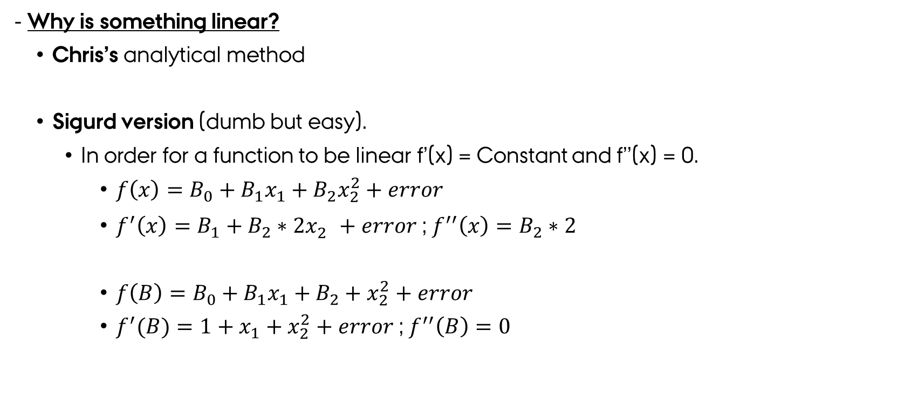
Linear:
- Why is something linear?
Chris’s analytical method
Sigurd version (dumb but easy).
In order for a function to be linear f’(x) = Constant and f’’(x) = 0.
$f\left(x\right)=B_{0}+B_{1}x_{1}+B_{2}x_{2}^{2}+error$
$f^{′}\left(x\right)=B_{1}+B_{2}∗{2x}_{2}^{}+error$ ; $f^{′′}\left(x\right)=B_{2}∗2$
$f\left(B\right)=B_{0}+B_{1}x_{1}+B_{2}+x_{2}^{2}+error$
$f^{′}(B)=1+x_{1}+x_{2}^{2}+error$ ; $f^{′′}\left(B\right)=0$

Slide 5
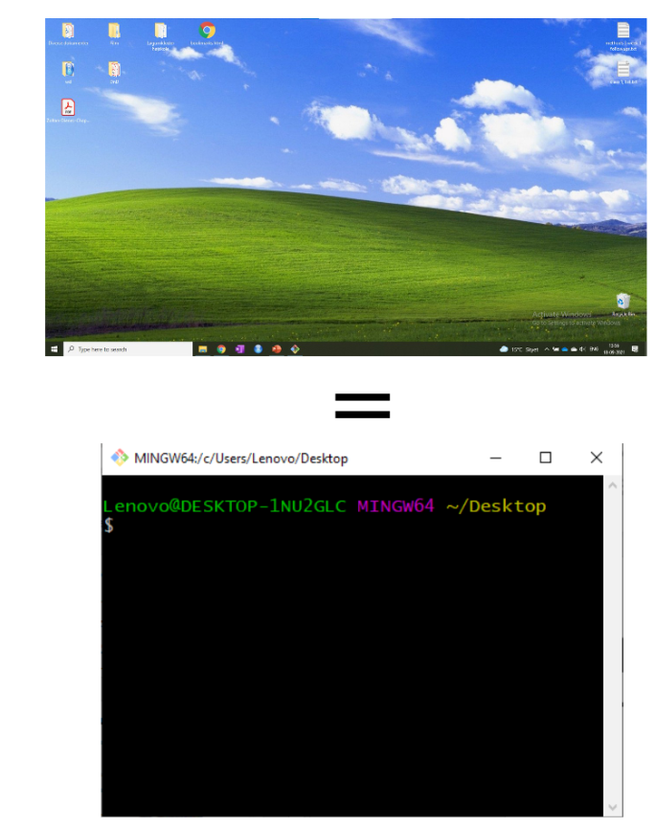
Github, Terminal and Git?!?!
Terminal:
WHAT IS IT!?
An old school hacker way to access your computer.
WHY?
Really useful when using GitHub and Git.
Much faster than drop and dragging once you get used to it.
Almost every workplace with programmers and software developers uses GitHub.
Types:
Shells:
Bash.
Cmd.
PowerShell.

Slide 6
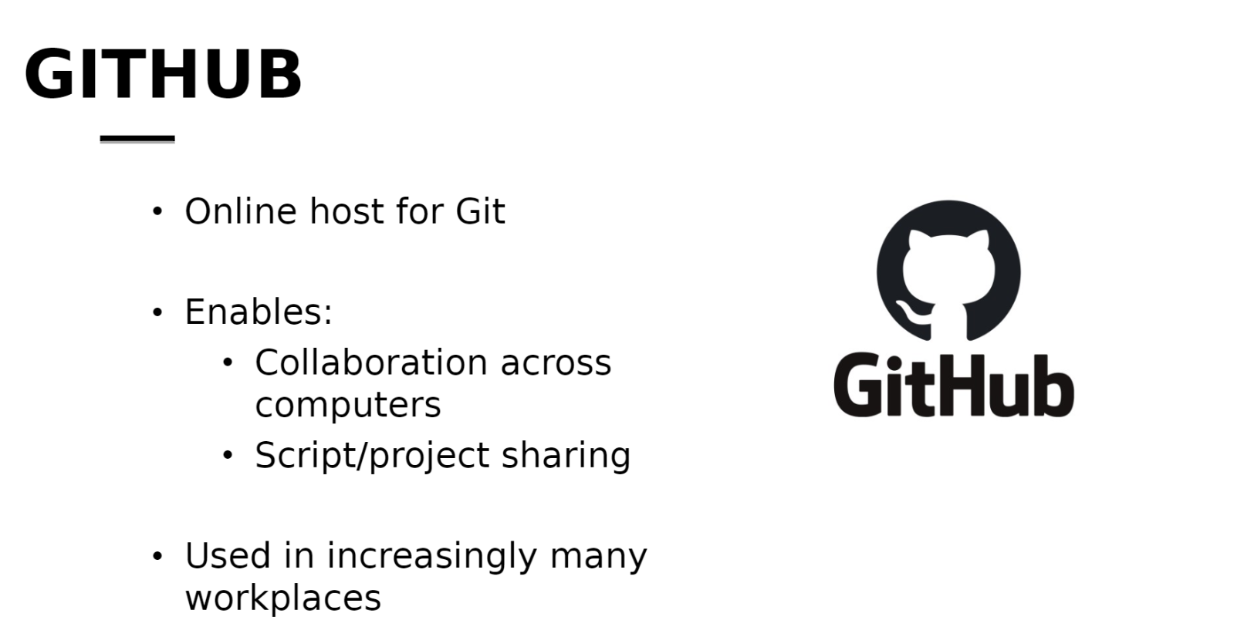
GitHub

Slide 7
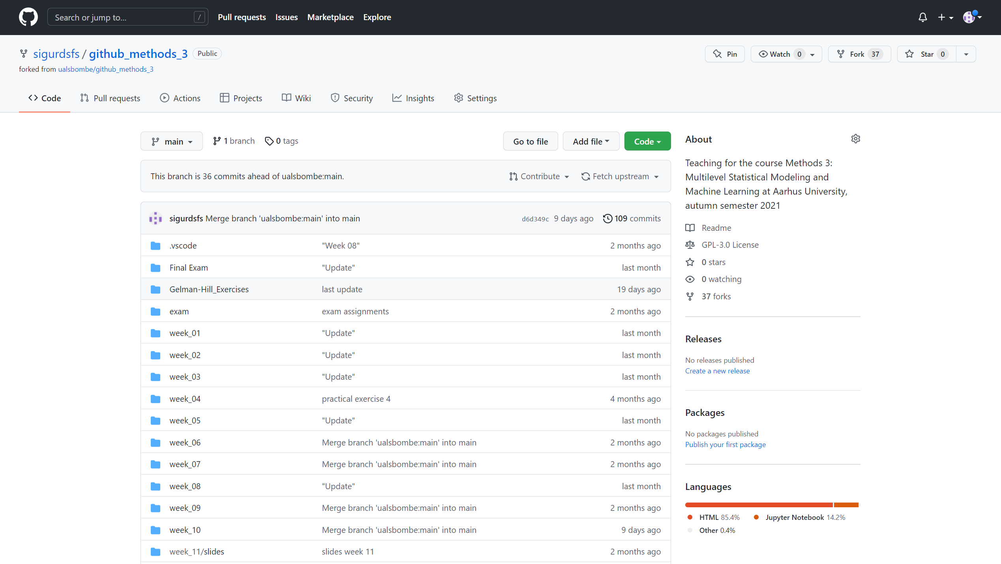
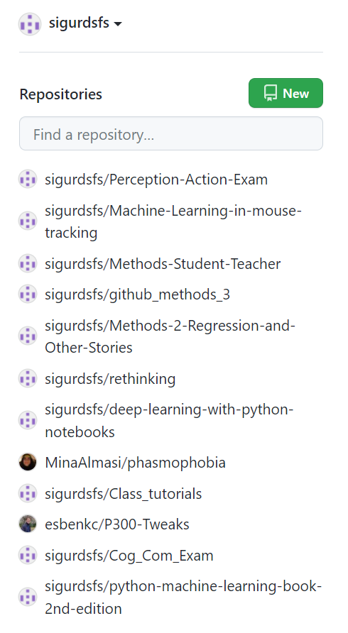
Overview of Github:

Slide 8
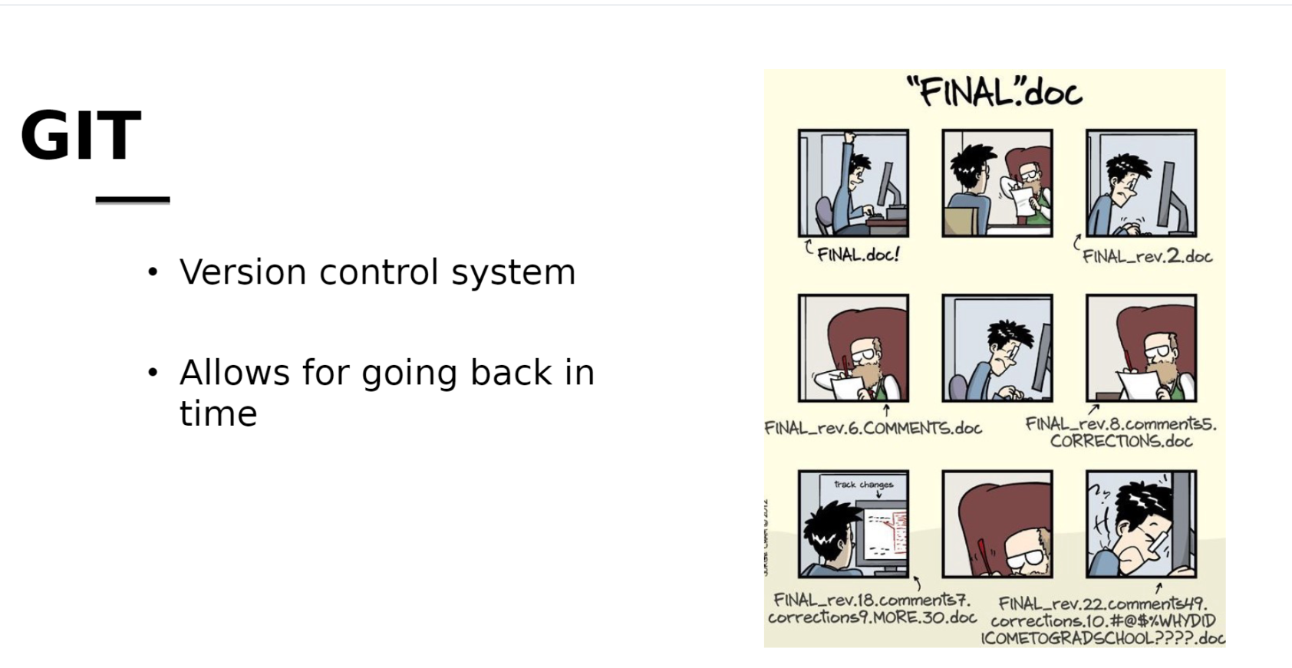
GitHub & Git

Slide 9
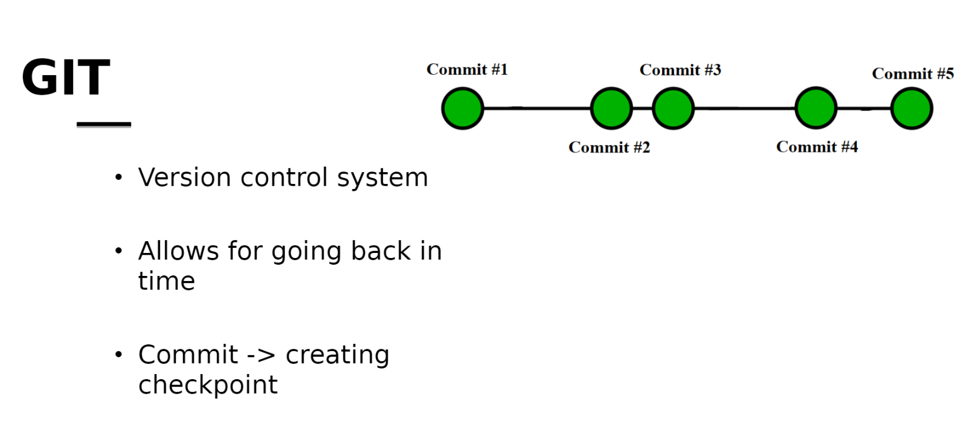
Github and Git

Slide 10
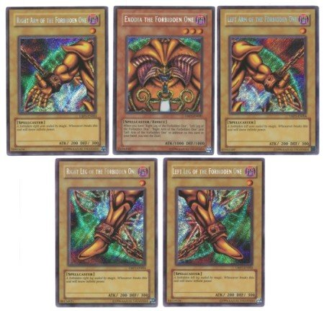
When we combine them all!
Tool that keep track of previous work.
Allows for cooperation on scripts at the same.
And also, a nice “online backup”.
Our plan
1) Methods 2 repository in GitHub, 2) We use Git to version control and upload to GitHub, 3) We use the terminal to command Git.
It will take some time to get comfortable and we will revisit this again.
Let’s try and do it together.

Slide 11
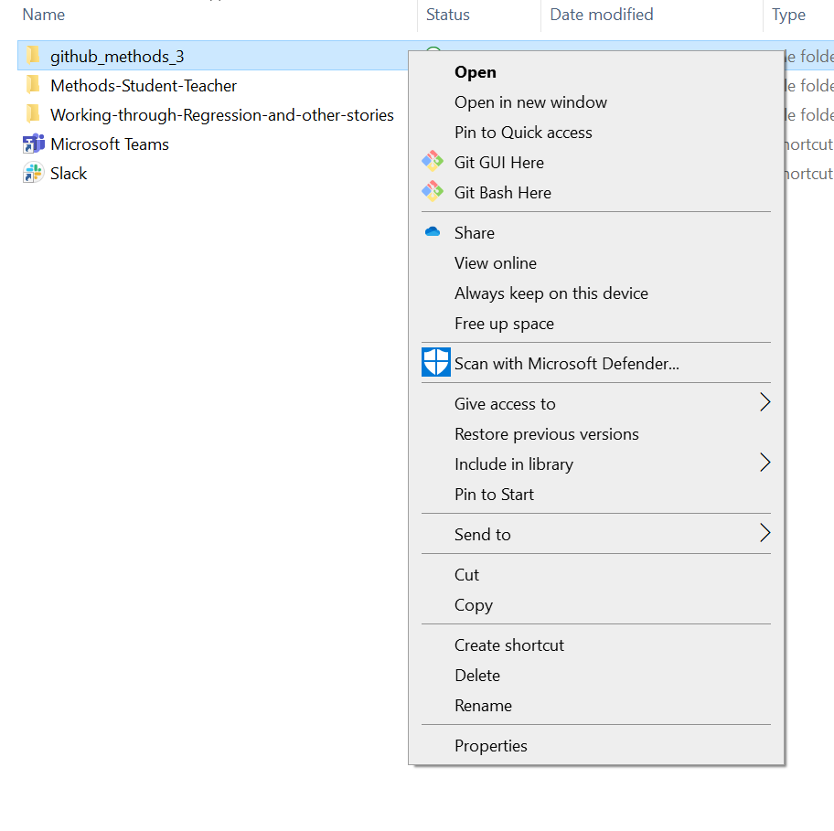
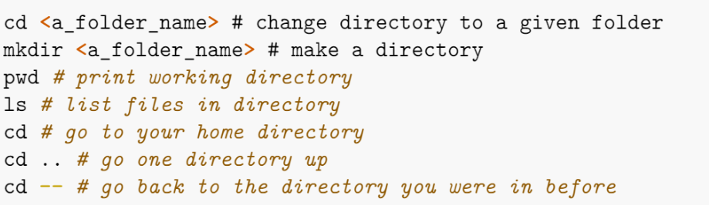
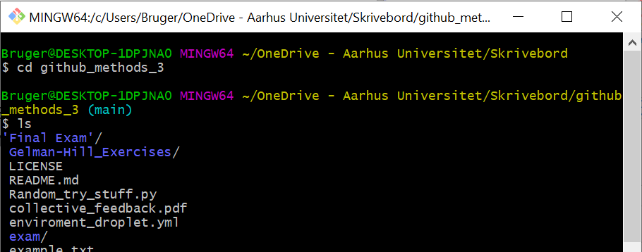
Step 1 (navigate)
Create/Fork a GitHub repository.
We must open our terminal and navigate to the right folder. Can be done 2 ways.
Using the right click method.
Using the terminal.
How to use the terminal: (commands)

Slide 12
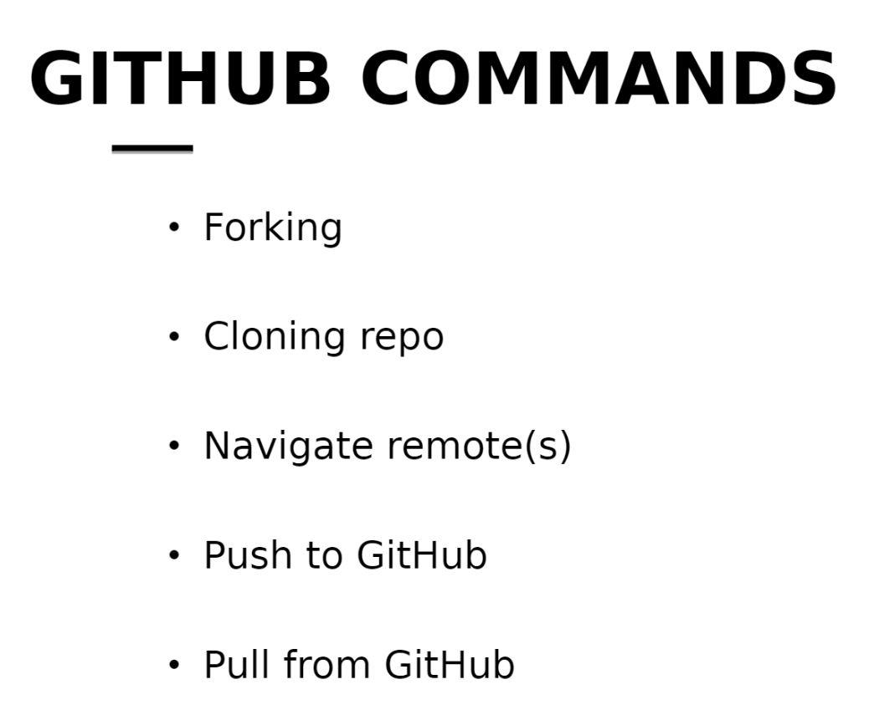
Step 2 (cloning time)
Terminal is in the desired location, and we want a local version of our GitHub.
Chris (upstream remote)
Fork
YOU (origin, remote)
Pull request
PUSH
PULL
PULL
NO PUSH
You (local)

Slide 13
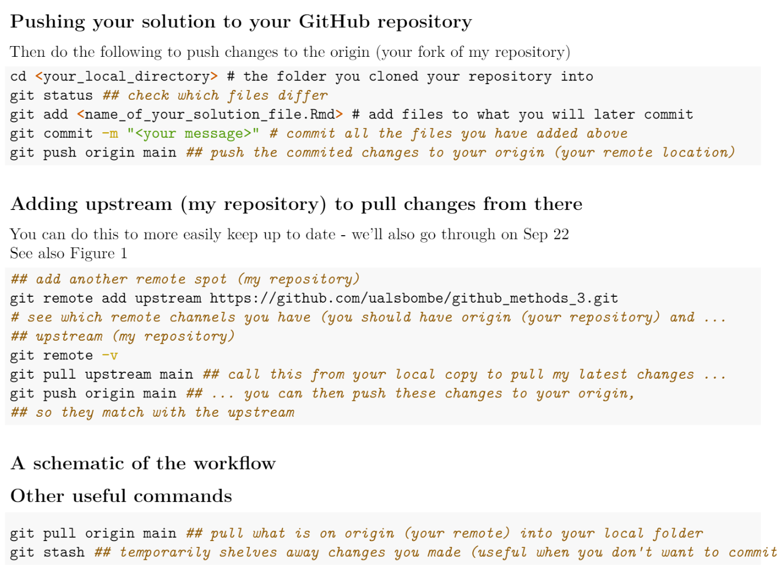
Step 3 (Version Control)
Now that we have a both a forked version of Chris repository and a local on our own computer it is time to manipulate. We either create a Rmd new folder or anything and want to stash it
Commands:

Slide 14
PHEW…..
A lot of information, you will have A LOT of bugs the first weeks…
Don’t despair it will work at some point. <3
Now let’s do some exercises to get it under our skin.
Find the “pushing_your_solutions.pdf” for an overview of commands
1) Fork https://github.com/chmathys/methods-2-course.
2) Clone your forked version.
3) Create a new folder with a .Rmd file in it.
4) Check the status of your local folder.
4) Add, Commit and Push the changes in your local folder to the online repository.

Slide 15

Break (MAYBE)

Slide 16
Recap of last semester:
Did you learn anything last semester?
What did you learn last semester?
My Perspective:
Introduction to the general and generalized linear model.
Lm() & Glm()
Ways to evaluate our models; Residuals, RSS, Information Criteria & Anova.
Multiple regression & interaction effects.
We learned about mixed effect models. Lmer(), glmer()
Overfitting and ways to counteract it.
Train/test split of our data. Prediction on unseen data is the best evaluation of a model.
Inter annotator agreement score.

Slide 17
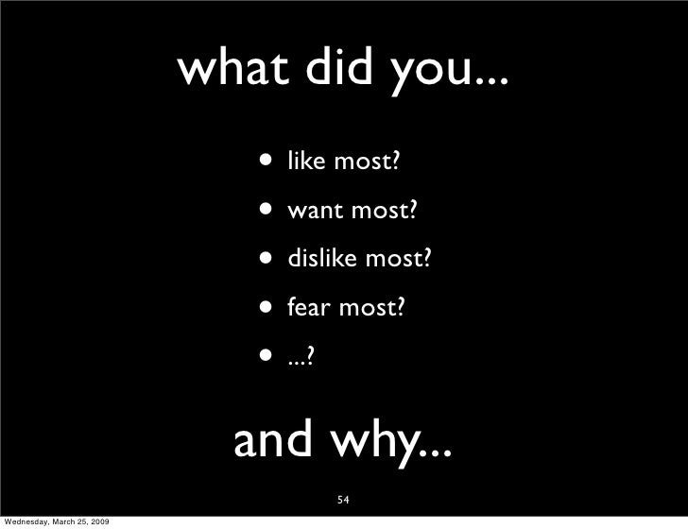
Feedback

Slide 18
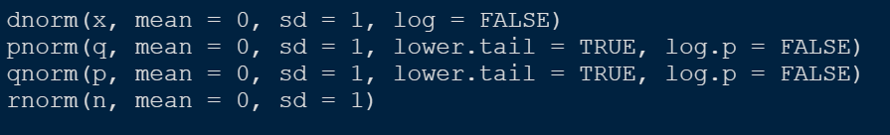
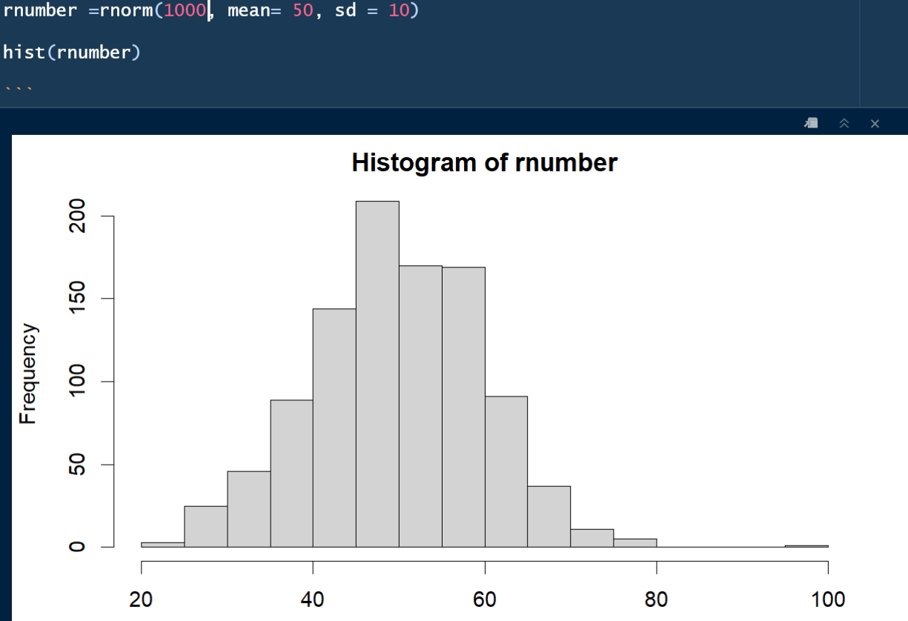
Couple of new Function().
When we want to simulate gaussian data or distribtuions:
We need rnorm() for today.
When would we want to simulate something that is
Gaussain?

Slide 19
Exercises for today.
Do exercise 1.2 in the book
Applying learned skills on your selected dataset: (IDEA)
Use a descriptive statistics and visual investigation to give a preliminary look into the data. (Use some of the things from chapter 2)
Create several models and discuss what each model reliably can infer anything about.
Mixed effect, which random effects? Logistic regression? Interaction effects? Should we dummy code some variables?
Do model comparison.
Test the model's prediction capability.
Write up a short summary of your model.
Do Exercise 2.3 in the book (Hard) hints. ( Summarise_at() , str_sub(), pivot_longer() )
Upload the .Rmd to your GitHub.

Slide 20

Thanks for today.
Next week we will follow the books exercises…
Check out Chris’ GitHub for a link to a cryptpad.
It is a text editor like google docs just encrypted. You should write the links to your GitHub.
You can also ask question in the cryptpad if there is something you don’t understand.

